Slide 1
Advanced Networking and Wireless
Benjamin Brewster

Slide 2

Why You Need to Care
Because someday you’ll have to:
Design and deploy a network for your business or home
Set up a nested router situation, where separate routers control different networks
Deploy WAPs in a complicated or already-congested building
Set up a VPN that encrypts traffic
No hands-on, follow-along-with-me stuff today

Slide 3
Firewalls
Firewalls protect your data and your services
Note that firewalls don't/can't interfere with traffic that isn't hitting them - so traffic solely through unmanaged switches never hits the firewall!
This is forgotten more often than you might think in network design

Slide 4
Firewalls
The term "firewall" can mean many things, but it usually means a device that processes packets.
Processing could mean allowing the packet through, allowing the packet through with modifications, or denying (dropping) the packet
Some devices scan the contents of those packets, not just the address information in the header
So-called Deep Packet Inspection means that the firewall can look for registered virus binaries, forbidden keywords, spam, etc. inside the packets

Slide 5
Firewalls
Some network devices can be programmed to be anything: router, switch, DHCP/DNS/other server, VPN end-point, firewall, etc.,
Confusingly, the device could be called any of these
This is typical in big-name boxes
Cisco
Juniper
Watchguard
HP
Dell
pfSense (company name is netgate)

Slide 6
Firewall Technologies
Two technologies are usually used together to authorize packets through and point them to the correct place:
Firewall Rules
Network Address Translation (NAT)
These technologies can be operated on schedules and can shape traffic/provide Quality of Service (QoS)
e.g. From 9am to 5pm, prioritize video chat and downloads, from 5pm to 9am, prioritize gaming traffic above all else

Slide 7
Firewalls
NAT allows port-forwarding for incoming connections
Recall that unless a LAN device makes a connection outbound first, WAN devices do not know where to find LAN devices (i.e. which port to use)
Incoming traffic addressed to unregistered/unused ports is normally blocked by Firewall Rules
NAT rules allow WAN devices to make first-contact with LAN devices
ROUTER
x0
x1
WAN
LAN
X
Initiating connection from WAN is blocked by Firewall Rules, as an open port wasn't targeted

Slide 8
Firewalls
NAT allows port-forwarding for incoming connections
Recall that unless a LAN device makes a connection outbound first, WAN devices do not know where to find LAN devices (i.e. which port to use)
Incoming traffic addressed to unregistered/unused ports is normally blocked by Firewall Rules
NAT rules allow WAN devices to make first-contact with LAN devices
ROUTER
x0
x1
WAN
LAN
Outbound connection from LAN device creates NAT mapping so that traffic back from WAN can find target LAN device

Slide 9
Firewalls
NAT allows port-forwarding for incoming connections
Recall that unless a LAN device makes a connection outbound first, WAN devices do not know where to find LAN devices (i.e. which port to use)
Incoming traffic addressed to unregistered/unused ports is normally blocked by Firewall Rules
NAT rules allow WAN devices to make first-contact with LAN devices
ROUTER
x0
x1
WAN
LAN
Port-forwarding NAT rule provides pathway for originating WAN connections to target a pre-determined LAN device

Slide 10

NAT example from networking class
NAT translation table
WAN side addr LAN side addr
1: host 10.0.0.1
sends datagram to
128.119.40.186:80
(source port 3345 randomly picked)
2: NAT router
changes datagram
source addr from
10.0.0.1:3345 to
138.76.29.7:5001,
updates table
138.76.29.7:5001 10.0.0.1:3345
…… ……
S: 10.0.0.1:3345
D: 128.119.40.186:80
10.0.0.1
1
2
S: 138.76.29.7:5001
D: 128.119.40.186:80
10.0.0.4
10.0.0.2
S: 128.119.40.186:80
D: 138.76.29.7:5001
3
138.76.29.7
S: 128.119.40.186:80
D: 10.0.0.1:3345
4
10.0.0.3
3: reply arrives
dest. address:
138.76.29.7:5001
4: NAT router
changes datagram
dest addr from
138.76.29.7:5001 to 10.0.0.1:3345

Slide 11
NAT Justified
Why NAT?
Out of IP addresses for LAN devices to all have unique ones
To hide internal devices and provide some obfuscation of them
If you don't need those (for example you're already inside a NAT router's control), you don't need NAT

Slide 12
Our Advanced Lab Network
Border Router
X1
X2
SiteLAN 192.168.1.0/24
WAN (NAT)
A border router, and two internal routers
All on separate, private subnets
Note that NAT is enabled on the internal routers, yet is unnecessary
This is common in practice because it's the default configuration!
WestRouter
EastRouter
X1
X2
X1
X2
WestLAN 192.168.2.0/24
EastLAN 192.168.3.0/24
WestAlpineCompy
EastAlpineCompy

Slide 13

pfSense as Border Router/Firewall
Say
Demonstrate
Let's look at some of the features of the Firewall in pfSense
Firewall rules are processed from top to bottom
Note how no Allow rules are present, and there are even explicit blocks in place to prevent private and bogon networks
Note how everything is allowed on the LAN
Boot:
Lab5_BorderRouter
Lab5_WestRouter
Lab5_EastRouter
Lab5_WestAlpineCompy
Lab5_EastAlpineCompy
CentOS GUI Reference VM, on SiteLAN Internal Network
With Firefox, connect to Lab5_BorderRouter at 192.168.1.1
Click on Firewall -> Rules -> WAN
Click on Firewall -> Rules -> LAN

Slide 14
What Devices Are Connected?
Say
Demonstrate
As we look at more complicated connection scenarios, we need to know what is connected to our border router
This list shows when they connected, what their address is, and what their hostname is.
All DHCP servers have this feature!
One common desire is to have a server, computer, or other device always have the same IP address. Problem is, if you set it statically on the device, then it can't be plugged in anywhere: it'll just not work on other networks
Instead of this, you can give it a static mapping, so that whenever its MAC address shows up, it gets the same IP address, and yet always to get one wherever it plugs in. You can also thus manage its DHCP settings from the DHCP server, instead of the box
Click on Status -> DHCP Leases
To do this, you would click the "Add static mapping" button in the Actions list in the row of the VM device you want to set
Show the static leases for this router at the bottom, and on the Services -> DHCP Server page

Slide 15
pfSense as Internal Router/Firewall
Say
Demonstrate
Now let's connect to the West Router
Reset the networking state so that it picks up a DHCP address from the West Router
Firewall rules are processed from top to bottom
Note that packets from so-called private networks (192.168.X, 10.X, etc.) are usually dropped by default. For this example, since we're going to be nesting routers with private networks, I've removed this rule from this firewall
Note that I've added an accept ICMP rule to the WAN, so we can ping the router from the WAN, and we can SSH to this router from the WAN
Any incoming packets that don't match any of these rules are dropped; this is typical behavior: rulesets are usually ordered whitelists
Switch the Internal Network of the CentOS GUI VM to be Lab5_WestRouter
$ sudo systemctl restart network.service
With Firefox, connect to Lab5_WestRouter at 192.168.2.1
Click on Firewall -> Rules -> WAN

Slide 16
pfSense as Internal Router/Firewall
Say
Demonstrate
See how the port-forward is set up as part of NAT: this allows us to ssh to either the router OR a machine inside the firewall
I chose to set port 2222 as the port that WAN devices could target the internal WestAlpineCompy at with SSH connections
Such packets will be translated such that their destinations will be rewritten as the static IP'd WestAlpineCompy, with the port re-written as 22, which is where WestAlpineCompy is listening for SSH connections
Connects to the WestRouter's SSH server
Connects to the WestAlpineCompy
Click on Firewall -> NAT
On EastAlpineCompy:
$ ssh 192.168.1.110
$ ssh 192.168.1.110 -p 2222

Slide 17
pfSense as Internal Router/Firewall
Say
Demonstrate
Note no changes to the LAN: anything still goes!
Click on Firewall -> Rules -> LAN

Slide 18
Consequences: Routing, NAT, and VPNs
Border Router
X1
X2
SiteLAN 192.168.1.0/24
WAN (NAT)
WestRouter
X1: 192.168.1.110
X2: 192.168.2.1
EastRouter
X1
X2
X1
X2
All packets out of WestRouter's X1 appear to have come from 192.168.1.110:X, and must target that SAME address and port to re-enter… but where are the LAN devices really??
WestLAN 192.168.2.0/24
EastLAN 192.168.3.0/24
WestAlpineCompy
EastAlpineCompy

Slide 19
Consequences: Routing, NAT, and VPNs
Border Router
X1
X2
SiteLAN 192.168.1.0/24
WAN (NAT)
WestRouter
X1: 192.168.1.110
X2: 192.168.2.1
EastRouter
X1
X2
X1
X2
Traditional routing is used internally in place of NAT, because we aren't going to run out of IP addresses in here
All addresses are left alone, anyone can target anyone! Except…
WestLAN 192.168.2.0/24
EastLAN 192.168.3.0/24
WestAlpineCompy
EastAlpineCompy

Slide 20
Consequences: Routing, NAT, and VPNs
Border Router
X1
X2
SiteLAN 192.168.1.0/24
WAN (NAT)
Since WestAlpineCompy's LAN network is 192.168.2.0, and the default WAN gateway is WestRouter…
And SiteLAN's LAN network is 192.168.1.0, and the default WAN gatway is BorderRouter, then neither of those know where to find EastLAN!
WestRouter
X1: 192.168.1.110
X2: 192.168.2.1
EastRouter
X1
X2
X1
X2
WestLAN 192.168.2.0/24
EastLAN 192.168.3.0/24
WestAlpineCompy
EastAlpineCompy

Slide 21
Consequences: Routing, NAT, and VPNs
Border Router
X1
X2
SiteLAN 192.168.1.0/24
WAN (NAT)
Thus, a route is set up in WestRouter's routing table that maps 192.168.3.0 through the WAN interface of EastRouter
This becomes a second (non-default) gateway for WestLAN: anything destined for 192.168.3.0 is sent to the EastRouter's WAN interface, instead of BorderRouter
WestRouter
X1: 192.168.1.110
X2: 192.168.2.1
EastRouter
X1
X2
X1
X2
WestLAN 192.168.2.0/24
EastLAN 192.168.3.0/24
WestAlpineCompy
EastAlpineCompy

Slide 22
Consequences: Routing, NAT, and VPNs
Border Router
X1
X2
SiteLAN 192.168.1.0/24
WAN (NAT)
A VPN encrypts all data between two IP endpoints, and gives the two endpoints direct access to each other's networks
With WestRouter and EastRouter X1 WAN interfaces as endpoints, all traffic between them becomes encrypted
NAT breaks this, since routes don't mix with NAT
These three concepts are the subject of the Lab
WestRouter
X1: 192.168.1.110
X2: 192.168.2.1
EastRouter
X1
X2
X1
X2
WestLAN 192.168.2.0/24
EastLAN 192.168.3.0/24
WestAlpineCompy
EastAlpineCompy

Slide 23

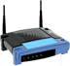

Wireless Access Point (WAP) Deployment
Ideally, the router should not have wifi so that we can assign it from a central authority
Maybe connected with PoE

Slide 24
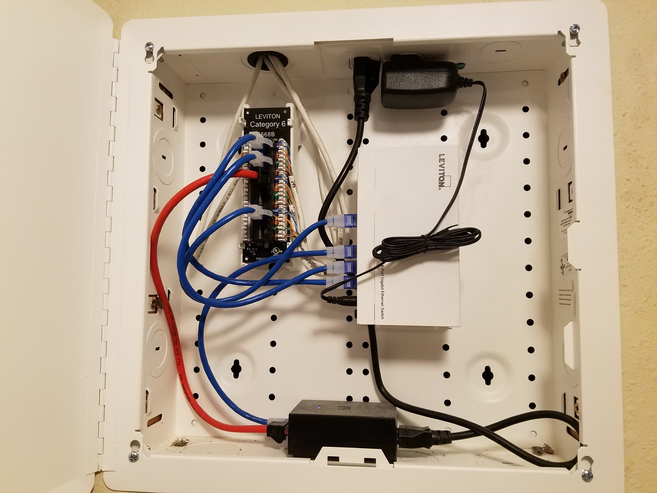
Network Cabinet on
my 2nd Floor
2: Switch splits one cable into many, including to WAP, PC, TV, etc.
1: Incoming network cable from down stairs
3: Data-only cable destined for WAP
5: Data+Power cable destined for WAP
4: Power over Ethernet injector

Slide 25
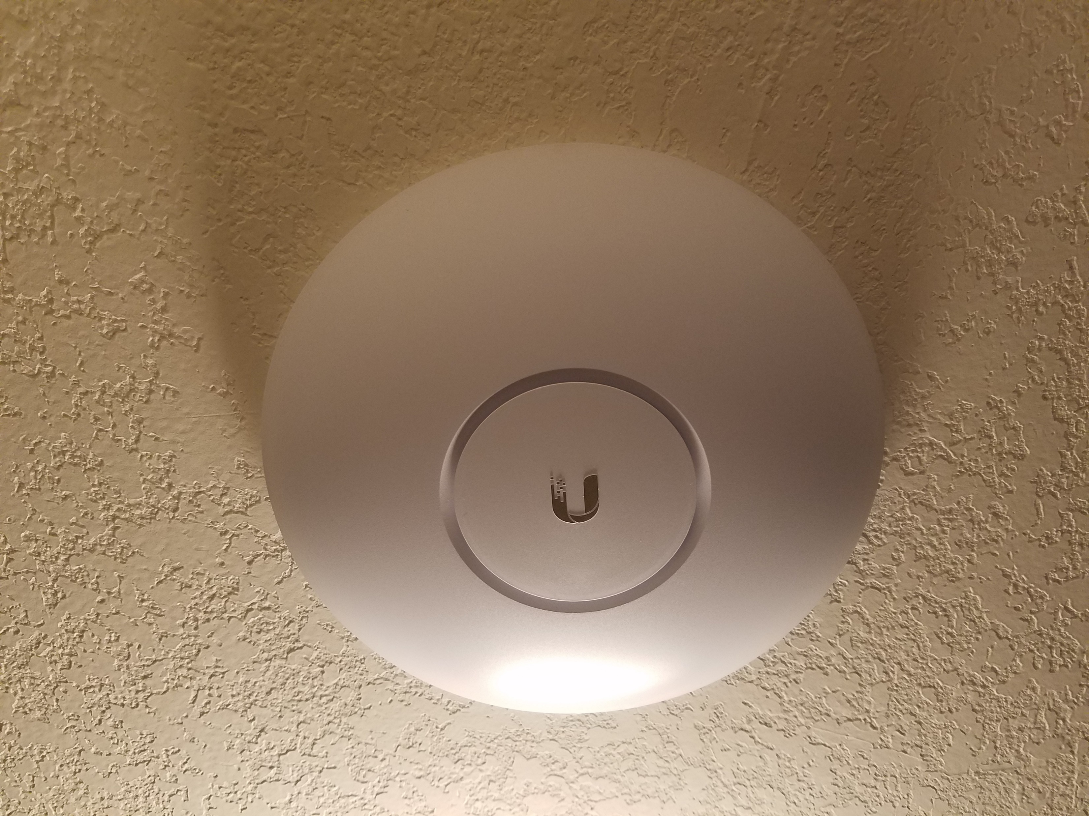
The WAP, a Ubiquiti
UAP-AC-PRO-US
802.11ac
2.4 & 5GHz
Outdoor rated,
~$130-170

Slide 26
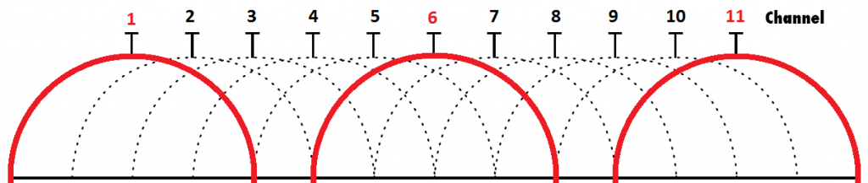
802.11 / WiFi
Choose encryption of data to and from WAP, usually WPA2 + AES these days
2.4GHz-2.485GHz spectrum divided into 11 channels at different frequencies
Administrator chooses frequency for WAP, or the WAP can auto-hop based on measured interference
Interference can come from any other source of same frequency
https://igscomputers.co.uk/how-to-choose-the-right-wi-fi-channel-and-avoid-interference/

Slide 27
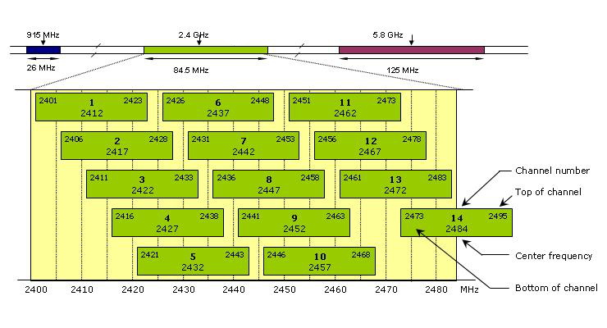
WiFi Channel Selection - Interference
https://photosync-app.com

Slide 28
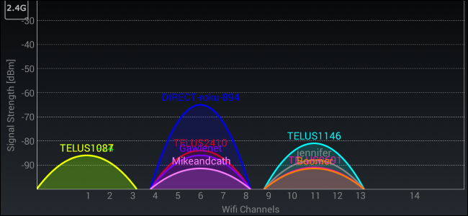
WiFi Channel Selection - Interference
It is worse to use the non-big three (1, 6, 11), even if they’re full!
Collisions happen on BOTH ends, and the result is a lower transmission rate
http://www.howtogeek.com/197268/how-to-find-the-best-wi-fi-channel-for-your-router-on-any-operating-system/

Slide 29
WAP Placement
When placing wireless access points in a building, use a method that:
Centralizes the WAPs physically (i.e. make sure the radio energy isn't wasted)
Like SLC
Don't block them with metal
Like Church
Separates the channels from overlapping (as much as possible)
Uses the same SSID (network name) and password
Turn off low data rates if possible:
Some WAPs offer low data rates, which makes devices “stick” to them as they move around, which prevents devices from associating with closer, better WAPs
In some cases, using different SSIDs will help the users to know which WAP they’re connected to, if stickiness is a problem

Slide 30
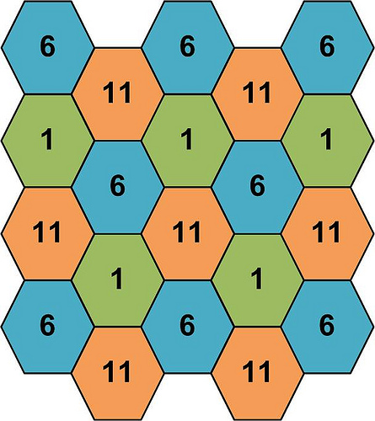
WAP Placement
1
6
11
1
http://forum.projetoderedes.com.br/viewtopic.php?t=775

Slide 31
Conclusion
Network engineering is a fascinating career
Remember that NAT and Routes don't mix
Every router's WAN is some other router's LAN
Plan where WAPs should go to maximize their effectiveness

